Slide 1

Lifestyle Store - Project Web Application
Detailed Developer Report

Slide 2
Security Status – Extremely Vulnerable
Hacker can steal all records from the databases of the website. (SQLi)
Hacker can take control of complete server including View, Add, Edit, delete files and folders. (Shell Upload)
Hacker can change source code of application to host malware, phishing pages or even explicit content. (Shell Upload)
Hacker can inject client side code into applications and trick users by
changing how page looks to steal information or spoil the name of the company. (XSS)
Hacker can execute any commands to extract information from website and deface it. (Admin panel access)
Hacker can easily view default and debug pages, can easily guess the default passwords and can exploit all the vulnerability related to the third party components used. (Security misconfiguration)

Slide 3
Vulnerability Statistics
Critical
13
Severe
11
Moderate
4
Low
6

Slide 4
Vulnerabilities
No | Severity | Vulnerabilities | Count
1 | Critical | SQL Injections | 3
2 | Severe | Reflected and Stored Cross Site Scripting | 2
3 | Severe | Insecure Direct Object Reference | 3
4 | Critical | Rate Limiting Issues | 1
5 | Critical | Insecure File Uploads | 1
6 | Moderate | Client side filter bypass | 1
7 | Critical | Components with Known Vulnerability | 3
8 | Critical | Default Admin Password | 1
9 | Low | Descriptive Error Messages | 1
10 | Low | Default Files and Pages | 5

Slide 5
Vulnerabilities
No | Severity | Vulnerabilities | Count
11 | Critical | Remote File Inclusion | 1
12 | Moderate | Directory Listing | 2
13 | Moderate | PII Leakage | 1
14 | Severe | Open Redirection | 1
15 | Severe | Bruteforce Exploitation of Coupon Codes | 1
16 | Critical | Command Execution Vulnerability | 2
17 | Severe | Forced Browsing | 2
18 | Severe | Cross-Site Request Forgery | 2
19 | Critical | Seller Account Access | 1

Slide 6
1. SQL Injection
SQL Injection (Critical) | Below mentioned URL in the online e-commerce portal is vulnerable to SQL injection attack Affected URL : http://3.110.85.145/products.php?cat=1 Affected Parameters : cat (GET parameter) Payload: cat=1’

Slide 7
1. SQL Injection
SQL Injection (Critical) | Here are other similar SQLi in the application Affected URL : http://13.234.115.86/products.php?cat=2 http://13.234.115.86/products.php?cat=3

Slide 8
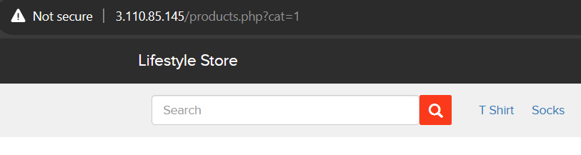
Observation
Navigate to the Main Page of the website where you will see categories option click on “ T Shirt” or “Socks” or “Shoes” to get into this URL, you will see products as per the category you have chosen but notice the GET parameter in the URL.

Slide 9
Observation
Now, we apply single quote in category parameter(i.e. GET parameter):
3.110.85.145/products.php?cat=1’ and we get complete MySQL error.

Slide 10
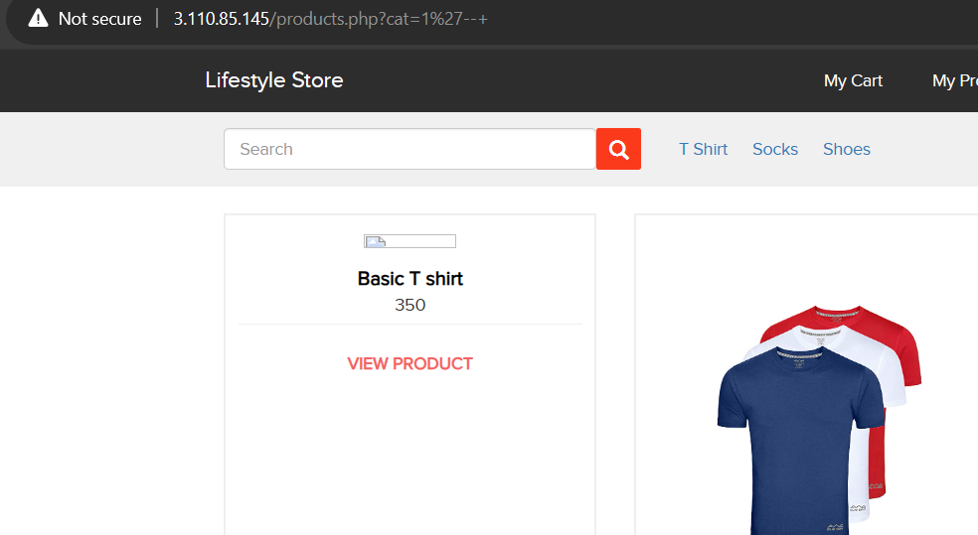
Observation
We then put --+ : 3.110.85.145 /products.php?cat=1’--+ and the error is removed confirming SQL injection:

Slide 11
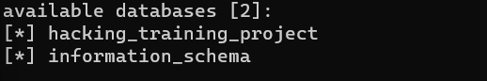
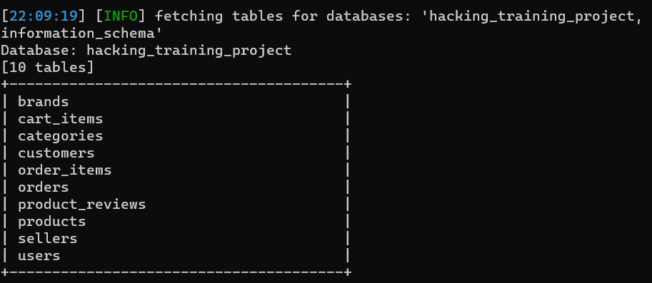
PoC – attacker can dump arbitrary data
No of databases: 2
hacking_training_project
information_schema
No of tables in hacking_training_project : 10
brands
cart_items
categories
customers
order_items
orders
product_reviews
products
sellers
users

Slide 12
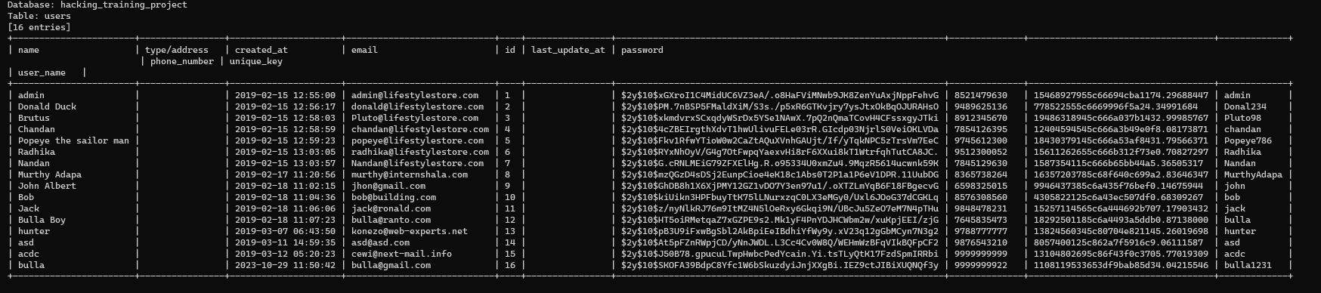
Business Impact – Extremely High
Using this vulnerability, attacker can execute arbitrary SQL commands on Lifestyle store server and gain complete access to internal databases along with all customer data inside it.
Below is the screenshot of users table which shows user credentials being leaked, although the password is encrypted yet vulnerable and can be misused by hackers.
Attacker can use this information to login to admin panels and gain complete admin level access to the website which could lead to complete compromise of the server and all other servers connected to it.

Slide 13
Recommendation
Take the following precautions to avoid exploitation of SQL injections:
Prepared Statements: Use SQL prepared statements available in all web development languages and frameworks to avoid attacker being able to modify SQL query.
Character encoding: If you are taking input that requires you to accept special characters, encode it. Example. Convert all ‘ to \’ , “ to \”, \ to \\. It is also suggested to follow a standard encoding for all special characters such has HTML encoding, URL encoding etc
Do not run Database Service as admin/root user
Disable/remove default accounts, passwords and databases
Assign each Database user only the required permissions and not all permissions

Slide 14
References
https://www.owasp.org/index.php/SQL_Injection
https://en.wikipedia.org/wiki/SQL_injection

Slide 15
2. Reflected Cross Site Scripting (XSS)
Cross Site Scripting (Severe) | Below mentioned parameters are vulnerable to reflected XSS, Affected URL : http://3.110.85.145/search/search.php?q=(here) Affected Parameters : q Payload: “><script>alert(1)</script>

Slide 16
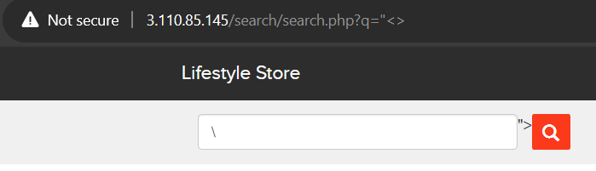
Observation
Log in to your account.
Then go to My Cart and then click on SHOP NOW button and type “<> in the Search Box.
You will notice that the code being reflected on the website.

Slide 17
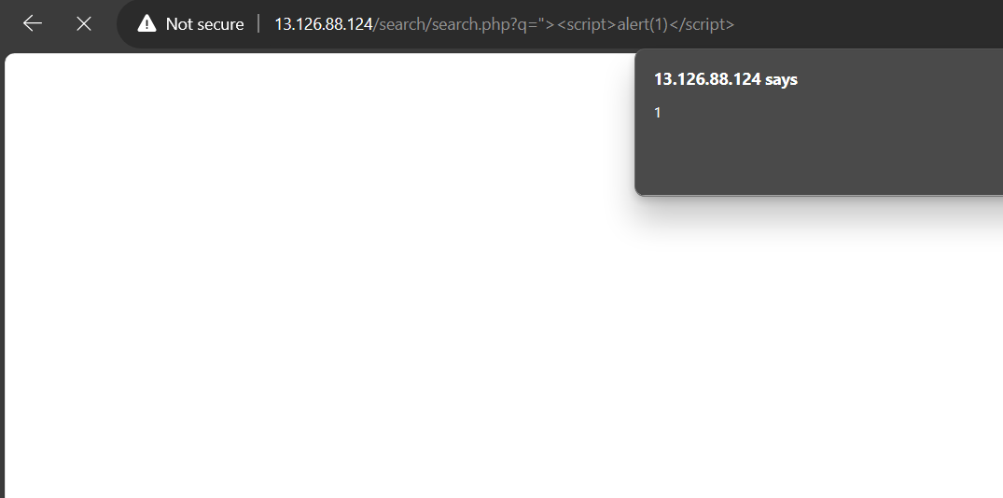
PoC – custom script was executed
Now, put the payload instead of “<> after the q parameter: “><script>alert(1)</script>
As you can see we executed custom JS causing popup.

Slide 18
2. Stored Cross Site Scripting (XSS)
Cross Site Scripting (Severe) | Below mentioned parameters are vulnerable to stored XSS, Affected URL : http://3.110.85.145/products/details.php?p_id=(all id’s) Affected Parameters : customer review text field Payload: <script>alert(1)</script>

Slide 19
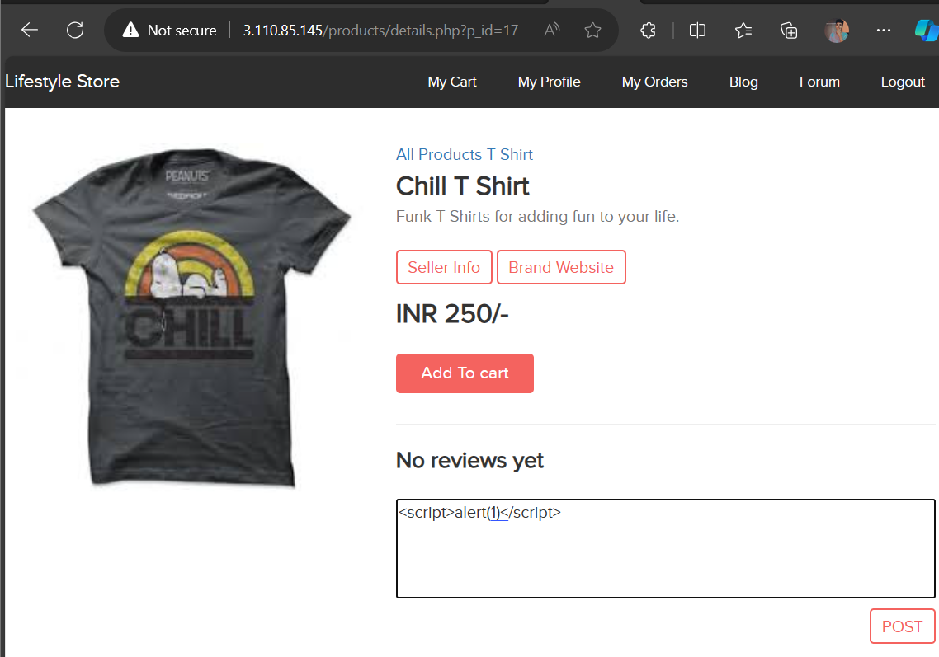
Observation
Log in to your account. Then go to My Cart and then click on SHOP NOW button and select any product, Or Navigate to 3.110.85.145/products/details.php?p_id=17 (here I selected product number 17).

Slide 20
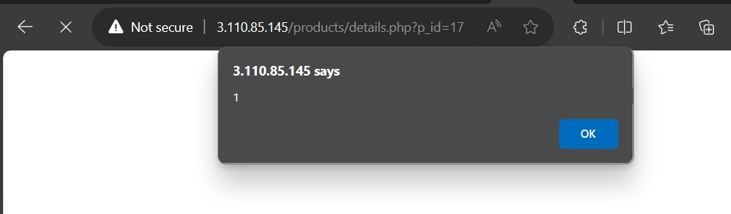
PoC – the script was executed
Put the payload as a customer review in the review field: <script>alert(1)</script> As you can see we executed custom JS causing popup.

Slide 21
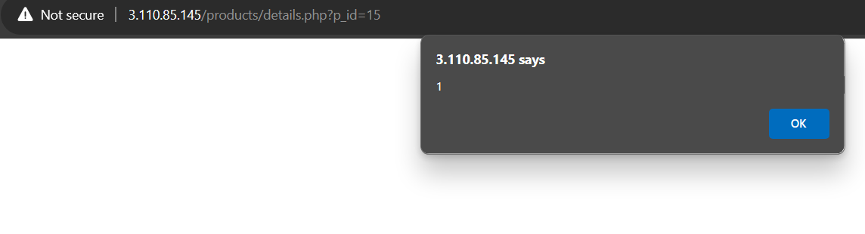
PoC

Slide 22
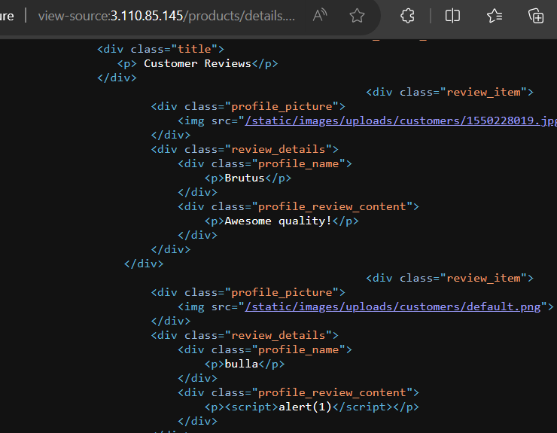
Business Impact – High
As attacker can inject arbitrary HTML CSS and JS via the review text field, attacker can put any content on the page like phishing pages, install malware on victim’s device and even host explicit content that could compromise the reputation of the organization.
All the attacker needs to do is to type in the malicious script in the review field and then anyone opening the link can be attacked by the hacker and victim would see hacker controlled content on the website. As the user trusts the website, he/she will trust the content too.

Slide 23
Recommendation
Take the following precautions:
Sanitize all user input and block characters you do not want.
Convert special HTML characters like ‘ “ < > into HTML entities &quot; %22 &lt; &gt;
before printing them on the website.

Slide 24
References
https://owasp.org/www-community/attacks/xss/
https://en.wikipedia.org/wiki/Cross-site_scripting
https://www.w3schools.com/html/html_entities.asp

Slide 25
3. Insecure Direct Object Reference
Insecure Direct Object Reference (Critical) | The My Orders section of the website suffers from an Insecure Direct Object Reference (IDOR) that allows attacker get access to other customers order details along with shipping details and payment modes, Affected URL : http://3.110.85.145/orders/orders.php?customer=(all customer id’s) Affected Parameters : customer (GET parameters)

Slide 26
3. Insecure Direct Object Reference
Insecure Direct Object Reference (Critical) | Similar issue is found on below modules too, Affected URL : http://3.110.85.145/products/details.php?p_id=(all id’s) http://3.110.85.145/forum/index.php?u=/user/profile/(any id) Affected Parameters : p_id (GET parameters) u=/user/profile/(any id)

Slide 27
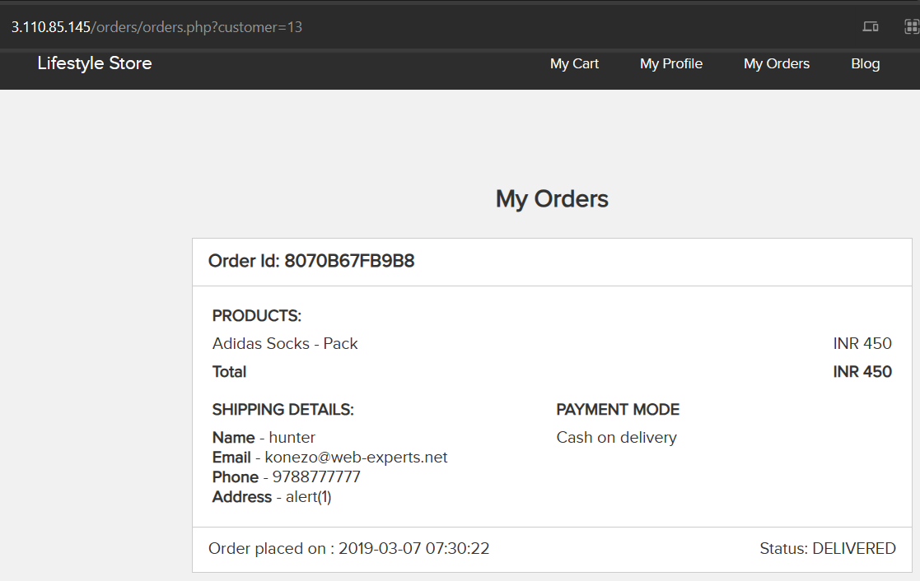
Observation
Login to your account and go to My
Orders section.
Your My Orders section will be shown to you.
Notice the URL : http://3.110.85.145/orders/orders.ph p?customer=13
It contains customer id of the user and we get the order details along with shipping details and payment mode of our user.

Slide 28
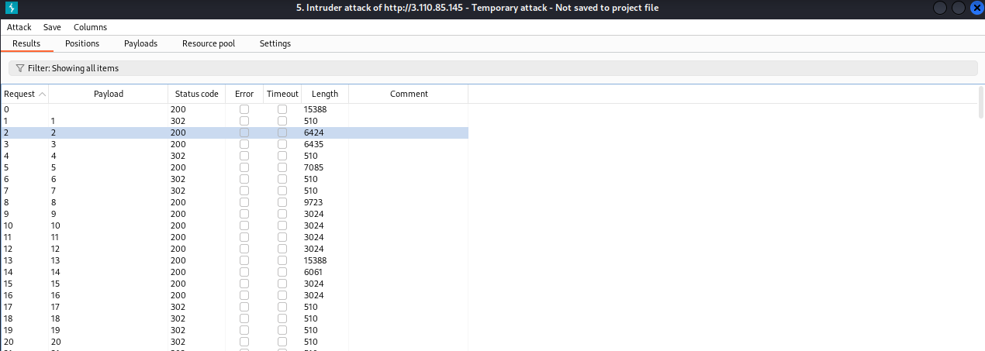
Observation
Since, the customer id is clearly visible, let’s intercept the request and brute force the customer id’s of all available customers.

Slide 29
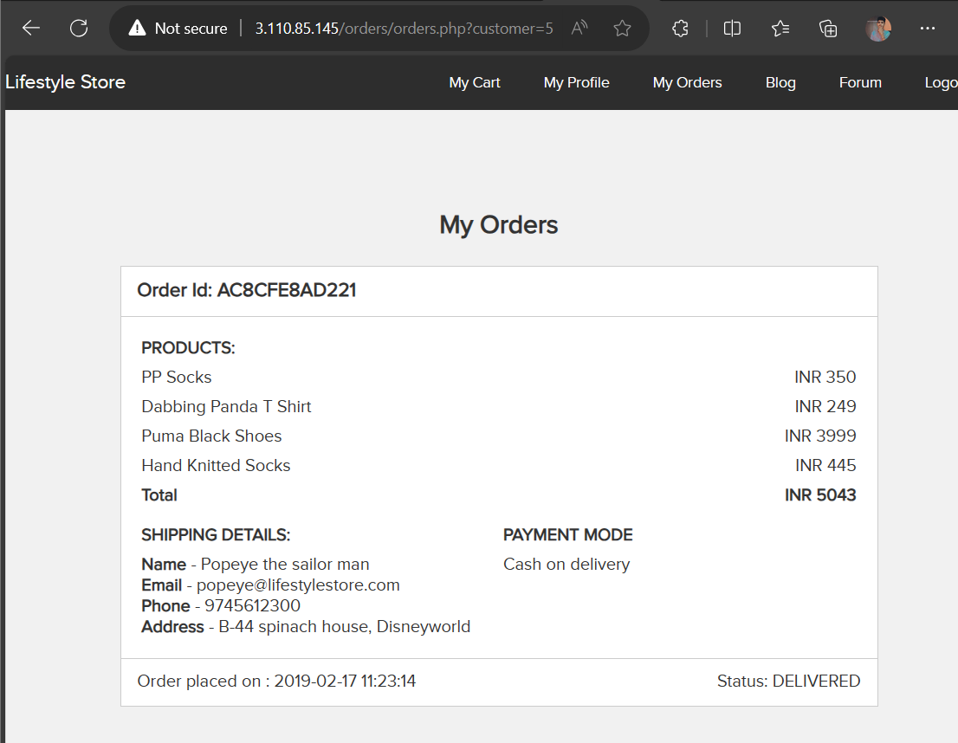
PoC – accessing other customer’s details
Now, we change the customer id to 5.
We get the order details along with shipping details and payment mode of other customers(here the user with customer id = 5).

Slide 30
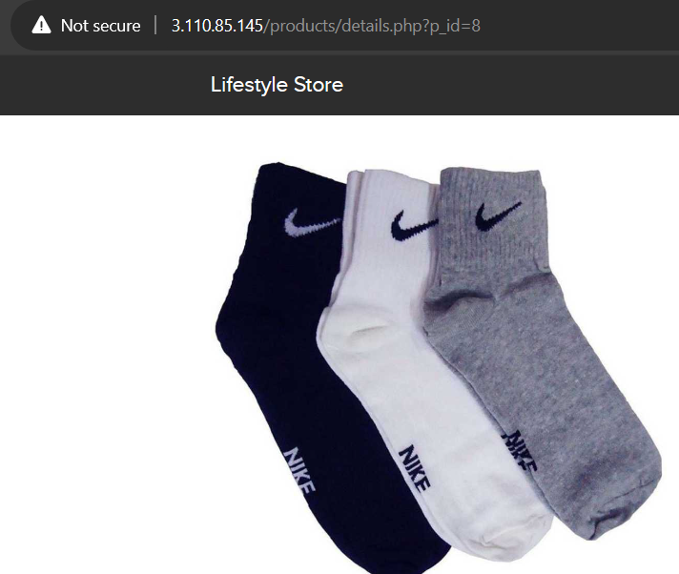
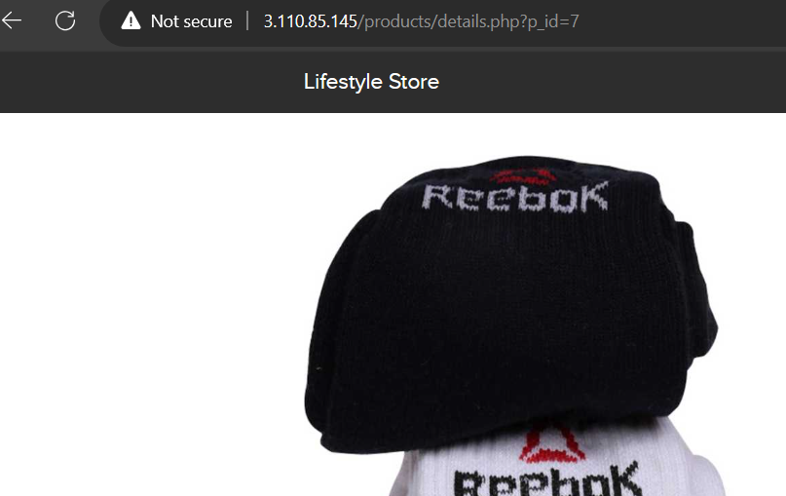
PoC
Just by changing the product id, other products can be seen.

Slide 31
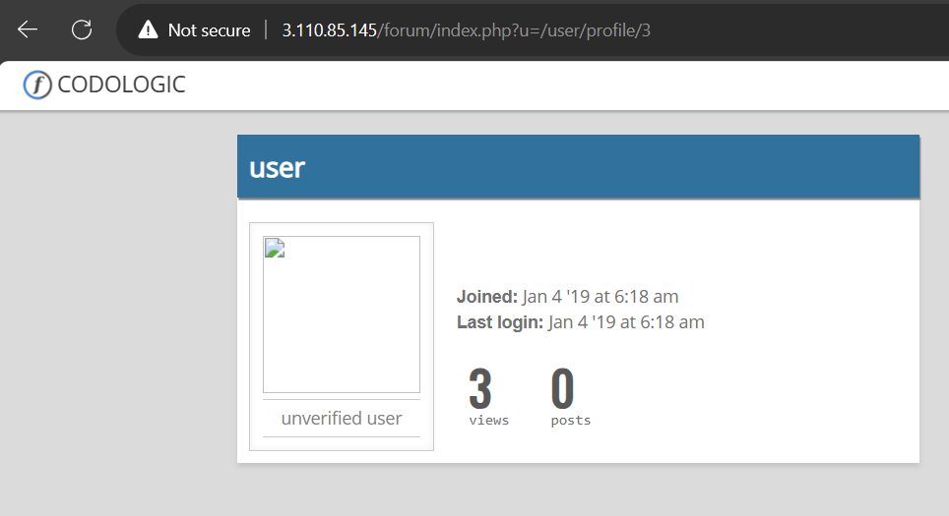
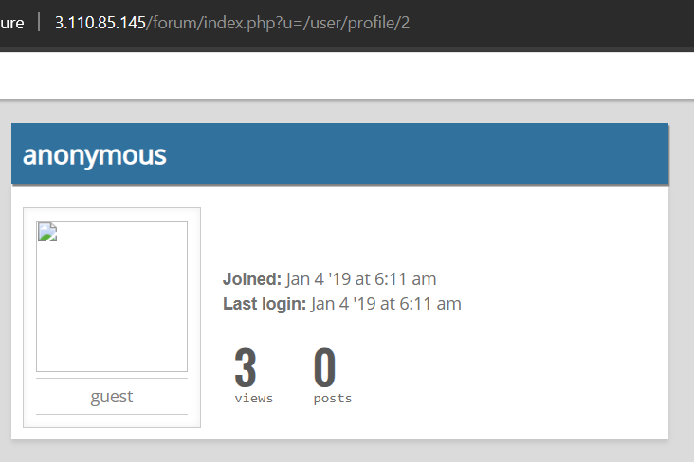
PoC
Just by changing the profile id, other user’s profile can be seen.

Slide 32
Business Impact – Extremely High
A malicious hacker can read order information of any user just by knowing the customer id. This discloses critical order information of users including:
Name
Mobile Number
Email Address
Physical Address
Order Id
Bill Amount and Breakdown
Payment Mode
This can be used by malicious hackers to carry out targeted phishing attacks on the users and the information can also be sold to competitors/black-market.
More over, as there is no rate limiting checks, attacker can brute force the customer id for all possible values and get bill information of each and every user of the organization resulting is a massive information leakage.

Slide 33
Recommendation
Take the following precautions:
Make sure each user can only see his/her data only.
Use proper rate limiting checks on the number of request comes from a single user in a small
amount of time.
Implement proper authentication and authorization checks to make sure that the user has permission to the data he/she is requesting.

Slide 34
References
https://www.owasp.org/index.php/Insecure_Configuration_Management
https://www.owasp.org/index.php/Top_10_2013-A4- Insecure_Direct_Object_References

Slide 35
4. Rate Limiting Issues
Account Takeover Using OTP Bypass (Critical) | The below mentioned login page allows login via OTP which can be brute forced, Affected URL : http://3.110.85.145/login/admin.php Affected Parameters : otp (POST parameters)

Slide 36
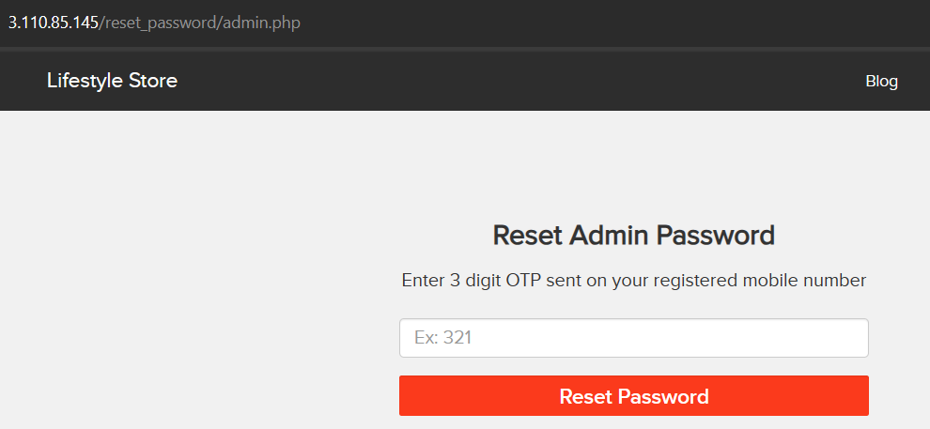
Observation
Navigate to http://3.110.85.145/login/admin.php, you will see a “Forgot your password?” hyperlink which asks for OTP which is sent to admin’s phone number, write any 3-digit number (i.e. any number from 100 - 999) and Intercept the request with Burp Suite.

Slide 37
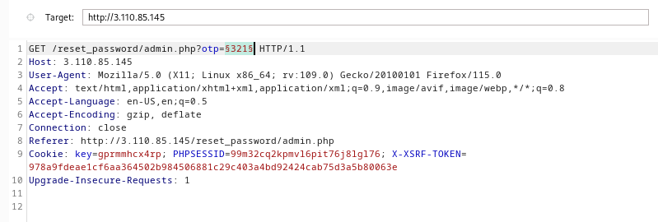
Observation
Following request will be generated containing OTP parameter(GET).

Slide 38
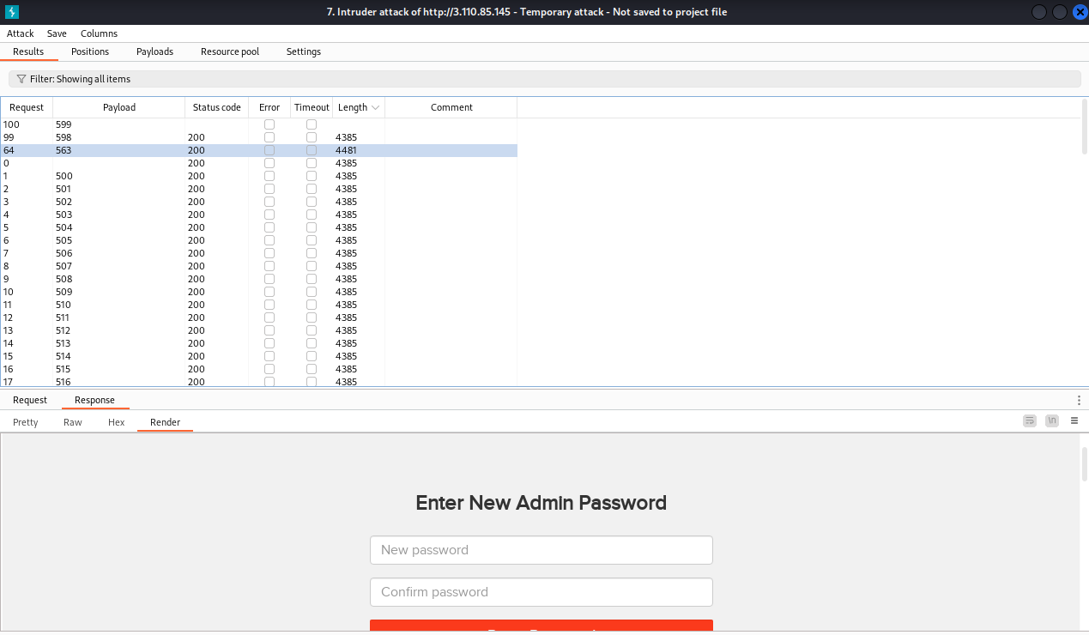
Observation
We shoot the request with all possible combinations of 3 Digit OTPs and upon a successful hit, we get a response containing user details(i.e. the correct OTP). We can use this OTP to reset admin password and then use the new admin password to login as administrator.
OTP for this Session was 563.

Slide 39
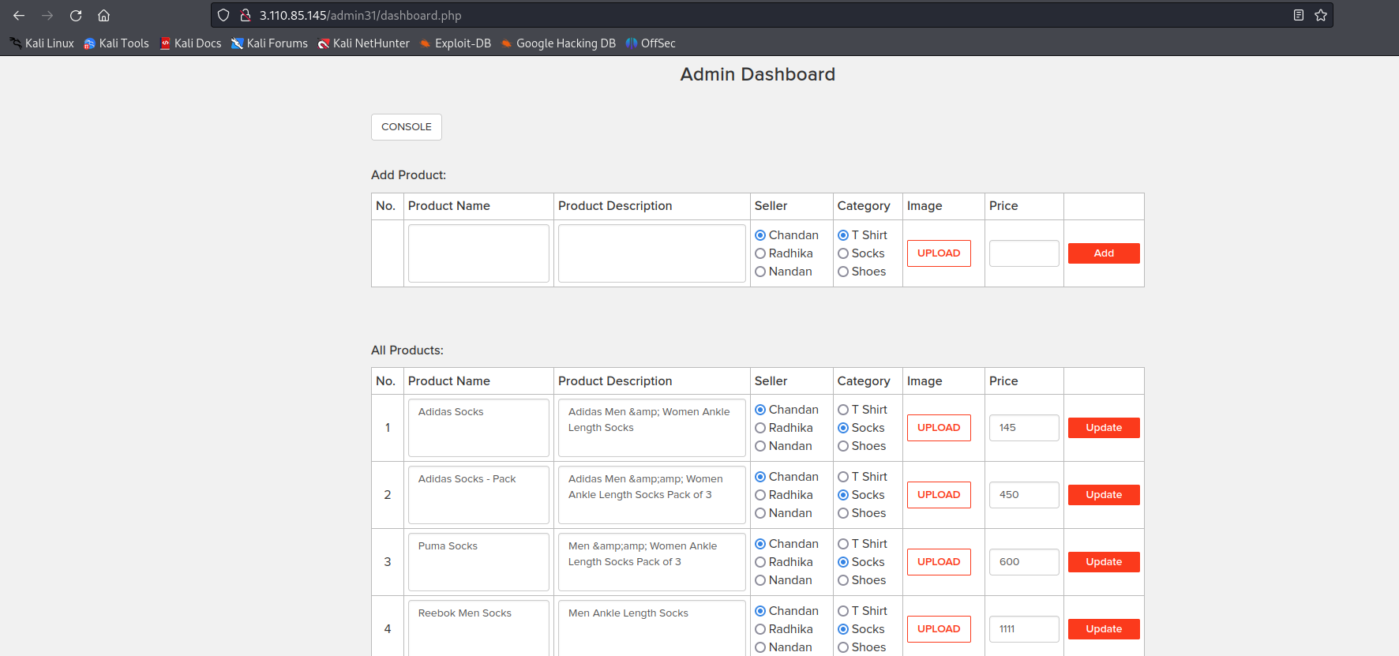
PoC – access to admin dashboard

Slide 40
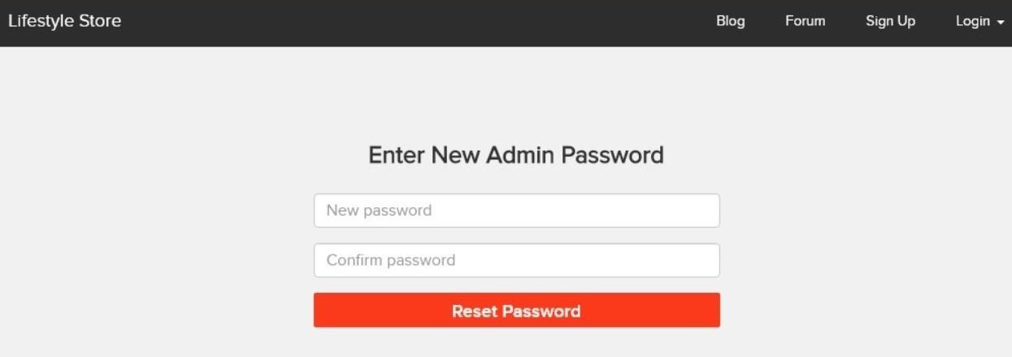
Business Impact – Extremely High
A Malicious hacker can gain complete access to admin account just by Brute-Forcing due to rate limiting flaw as a hacker can attempt as many times as he wants , as there is no bounds in no of tries. This leads to complete compromise of personal user data of every customer.
Once the attacker logs in as admin, then he can carry out actions on behalf of the victim(admin) which could lead to serious financial loss to him/her, like he can change the name, picture and even price of the products.

Slide 41
Recommendation
Take the following precautions:
Use proper rate-limiting checks on the no of OTP checking and Generation requests.
Implement anti-bot measures such as ReCAPTCHA after multiple incorrect attempts.
OTP should expire after certain amount of time like 2-5 minutes.
OTP should be at least 6 digit and alphanumeric for more security.

Slide 42
References
https://www.owasp.org/index.php/Testing_Multiple_Factors_Authentication_(OWASP-AT-009)
https://www.owasp.org/index.php/Blocking_Brute_Force_Attacks

Slide 43
5. Insecure File Uploads
Insecure File Uploads (Critical) | Below mentioned URL is vulnerable to insecure file uploads, Affected URL : http://52.66.88.120/wondercms/ File Uploaded : backdoor shell (anonymous.php)

Slide 44
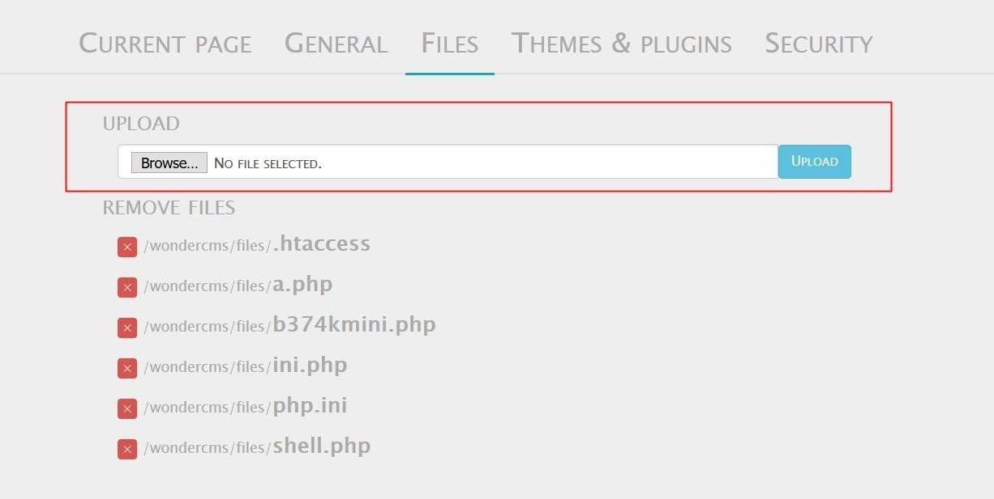
Observation
Navigate to the Blog section of the website and login as admin.
Now, navigate to the Settings and then go to Files option.
You will notice an Upload section here,

Slide 45
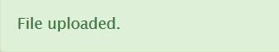
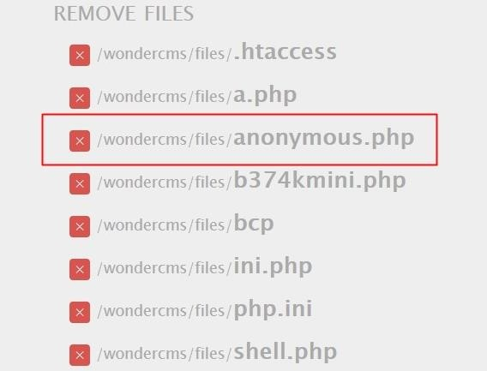
Observation
It looks like we can upload files here, let’s try uploading a file anonymous.php
And it’s successfully uploaded.

Slide 46
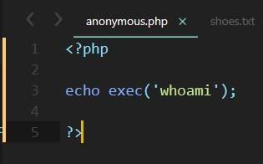
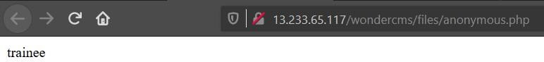
PoC - any command can be executed
Shell – anonymous.php
The uploaded shell was executed successfully.

Slide 47
Business Impact – Extremely High
The consequences of unrestricted file upload can vary:-
including complete system takeover, an overloaded file system or database.
forwarding attacks to back-end systems.
client-side attacks, or simple defacement.
It depends on what the application does with the uploaded file and especially where it is stored.

Slide 48
Recommendation
Take the following precautions:
The file types allowed to be uploaded should be restricted to only those that are necessary for
business functionality.
Never accept a filename and its extension directly without having a whitelist filter.
All the control characters and Unicode and the special characters should be discarded.

Slide 49
References
https://owasp.org/www-community/vulnerabilities/Unrestricted_File_Upload
https://www.hackingarticles.in/comprehensive-guide-on-unrestricted-file-upload/

Slide 50
6. Client Side Filter Bypass
Client Side Filter Bypass (Moderate) | Below mentioned URL is vulnerable to client side filter bypass. Affected URL : http://3.6.40.63/profile/16/edit/

Slide 51
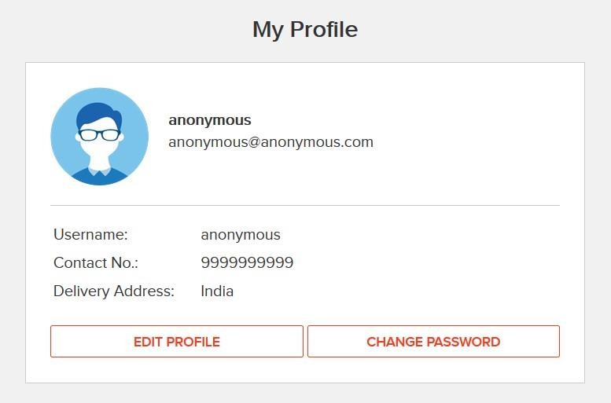
Observation
Login to your account and go to My Profile section.
Now, click on edit profile button, update any of your details, here I will go with phone number only.
I updated my phone number from 9876543211 to 9999999999.
Now, again click on UPDATE button and intercept the request with Burp Suite.

Slide 52
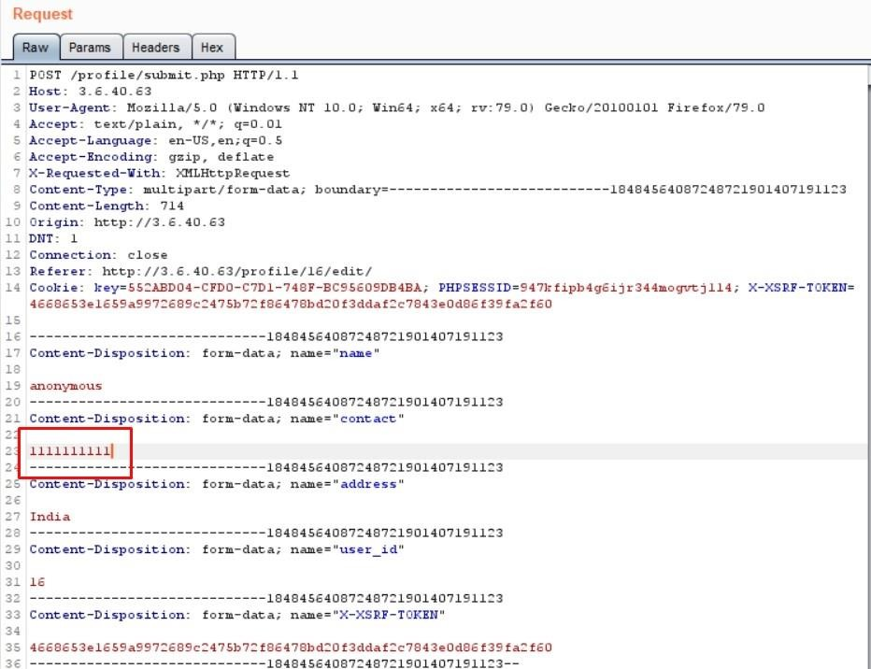
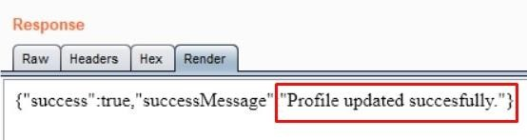
Observation
Now, send the request to the Repeater and edit the phone number.
I changed it from 9999999999 to 1111111111 and hit Send.

Slide 53
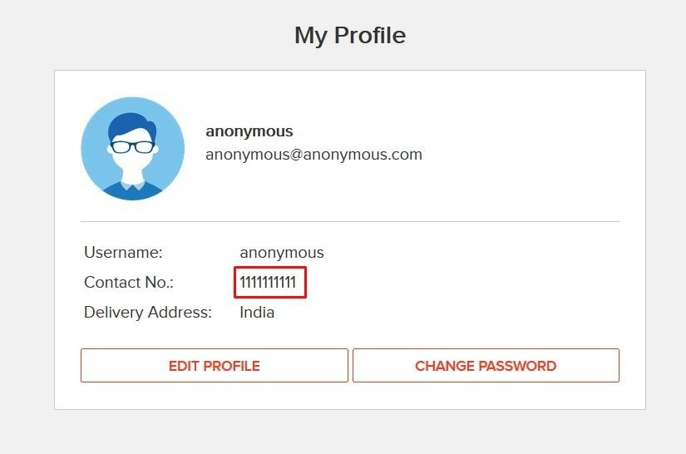
PoC – profile updated successfully
As PoC, a short screen recording has been attached along with in screen rec/client side filter bypass poc.mp4

Slide 54
Business Impact – High
This would only trouble the users who in turn might give negative feedback on your website.

Slide 55
Recommendation
Take the following precautions:
Implement all critical checks on server side code only.
Client-side checks must be treated as decorative only.
All business logic must be implemented and checked on the server code. This includes user input, the flow of applications and even the URL/Modules a user is supposed to access or not.

Slide 56
References
https://portswigger.net/support/using-burp-to-bypass-client-side-javascript-validation
https://www.slideshare.net/SamBowne/cnit-129s-ch-5-bypassing-clientside-controls

Slide 57
7. Components with Known Vulnerabilities
Components with Known Vulnerabilities (Critical) | Below mentioned URL contains components with known vulnerabilities. Affected URL: http://15.206.159.87/wondercms/ http://15.206.159.87/forum/ and the PHP Version.

Slide 58
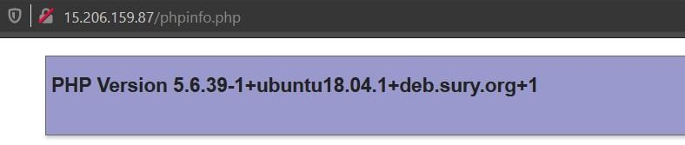
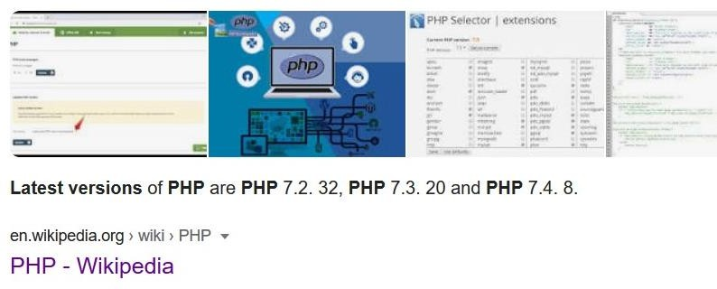
Observation
The php version of this website is 5.6.39-1 which is Out Dated.
Latest php version is 7.4.8

Slide 59

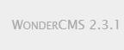
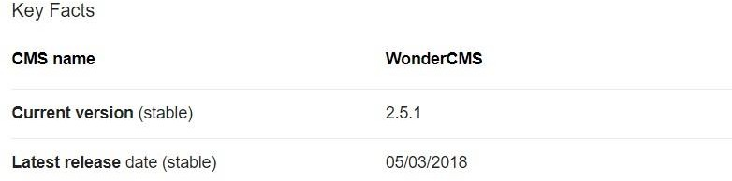
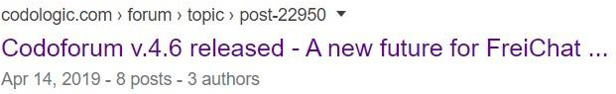
Observation
Upon checking the versions of these components they turned out to be Out Dated.
Versions being used,
Codoforum3.3.1
Latest Versions available,

Slide 60
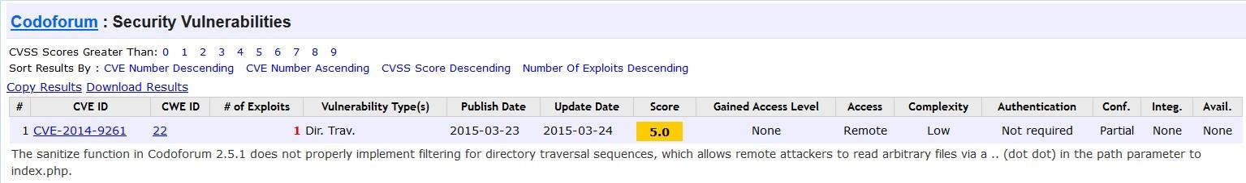
PoC
Codoforum has public exploits.

Slide 61
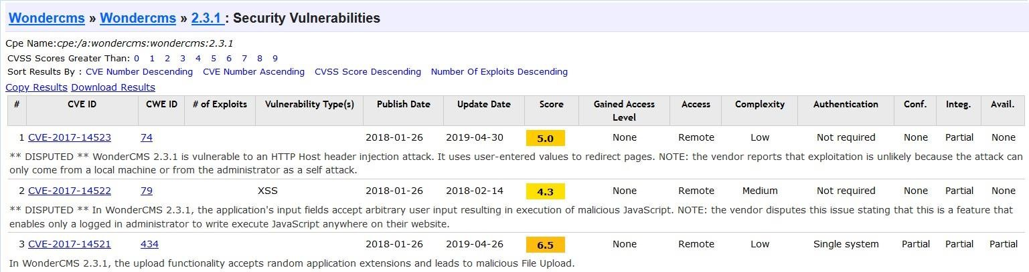
PoC
Wondercms 2.3.1 has public exploits.

Slide 62
Business Impact – Extremely High
Anyone can perform any attacks (available) as all the exploits are available publicly .
It can cause severe damage to the website
He may be able to upload backdoor shells
He will easily deface your website

Slide 63
Recommendation
Take the following precautions:
Update all the components and the php version which is running on it.
Hide the current versions info from there pages.

Slide 64
References
https://owasp.org/www-project-top-ten/OWASP_Top_Ten_2017/Top_10-2017_A9-
Using_Components_with_Known_Vulnerabilities
https://www.cvedetails.com/vulnerability-list/vendor_id-15088/product_id-30715/version_id-
235577/Wondercms-Wondercms-2.3.1.html
https://www.cvedetails.com/vulnerability-list/vendor_id-15315/Codoforum.html

Slide 65
8. Default Admin Password
Default Admin Password (Critical) | Below mentioned URL is using default admin credentials. Affected URL: http://15.206.159.87/ovidentiaCMS/index.php?tg=login&cmd=authform&msg=Co nnexion&err=&restricted=1 Component Name: ovidentia content management system

Slide 66
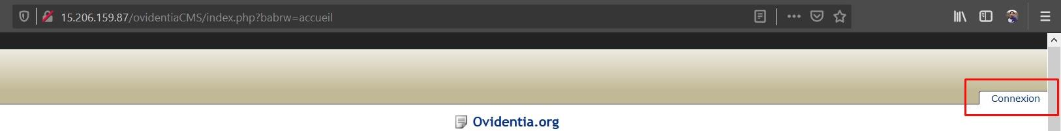
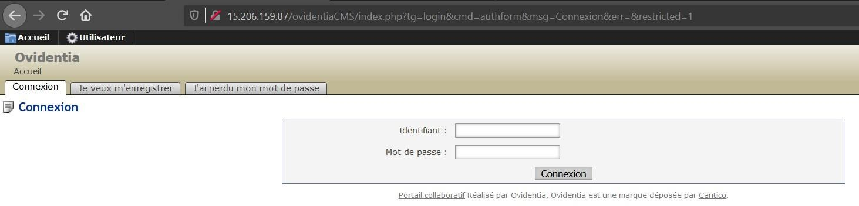
Observation
Navigate to http://15.206.159.87/ovidentiaCMS/
In the ovidentia CMS page there is option called Connexion to login as admin.
Upon clicking it we can see this page,

Slide 67
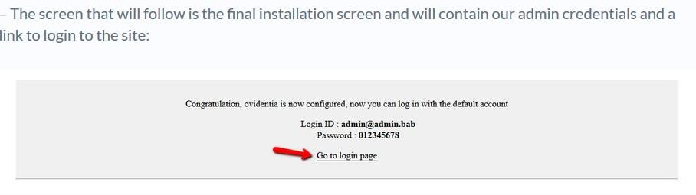
PoC - ovidentia CMS admin access
On searching for default ovidentia CMS admin credentials on the web we got,

Slide 68
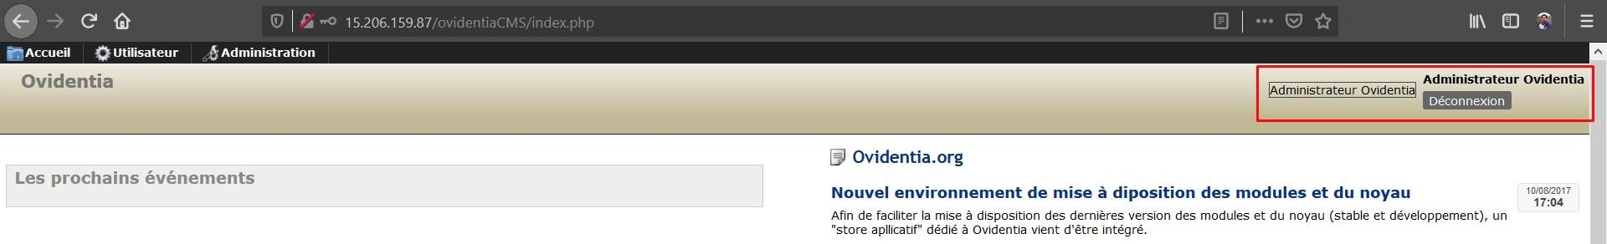
PoC
Upon entering the credentials we got the administrator access.

Slide 69
Business Impact – Extremely High
Attacker will have all the admin privileges.
He can easily deface the ovidentia CMS.

Slide 70
Recommendation
Take the following precautions:
Two- Factor Authentication for sensitive data should be added with strong passwords.
Disable the default debug pages.
Hide the admin login page.
Remove all the default passwords and add your own password which should be very strong. It must contain a special character, at least one lowercase letter, at least one uppercase letter, and a number and it must be greater than or equal to 8 digits for maximum security.

Slide 71
References
https://www.indusface.com/blog/owasp-security-misconfiguration/
https://hdivsecurity.com/owasp-security-misconfiguration
https://www.tmdhosting.com/kb/question/ovidentia-hosting-requirements-ovidentia-manual- installation/

Slide 72
9. Descriptive Error Messages
Descriptive Error Messages (Low) | Below mentioned URLs shows descriptive error messages, Affected URL: http://3.6.40.63/?includelang=lang/fr.php Affected Parameter: includelang

Slide 73
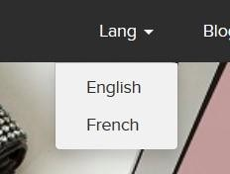
Observations
Navigate to the website and click on change language dropdown, and select any of the two languages.
Now, notice the URL, you get a ‘get’ parameter of includelang which shows descriptive error
messages.
Here, we enter the payload: includelang=lifestyle and on executing this file the page throws a descriptive error.

Slide 74
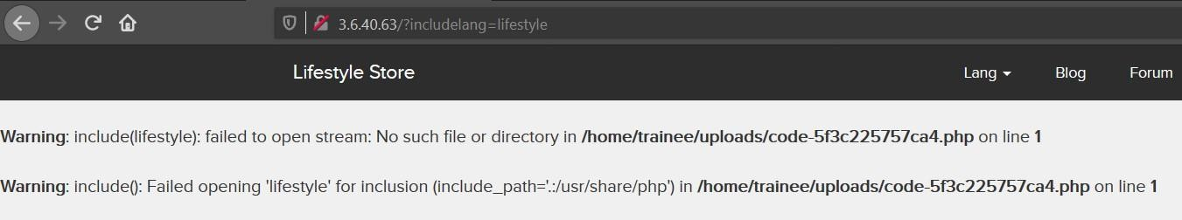
PoC – descriptive error message displayed

Slide 75
Business Impact – Low
It doesn’t harm the website directly, but it is letting the hacker to know about the website architecture which the hacker can to dig out internal resources and use them against the organization.

Slide 76
Recommendation
Take the following precautions:
Developers should turn off this descriptive error messages before the web application is
finally released for general public use.

Slide 77
References
https://cwe.mitre.org/data/definitions/209.html
https://owasp.org/www-community/Improper_Error_Handling

Slide 78
10. Default Files and Pages
Default Files and Pages (Low) | Below mentioned URLs shows default files and pages, Affected URL: http://3.6.40.63/ Default files and pages present: server-status robots.txt userlist.txt phpinfo.php composer.json

Slide 79
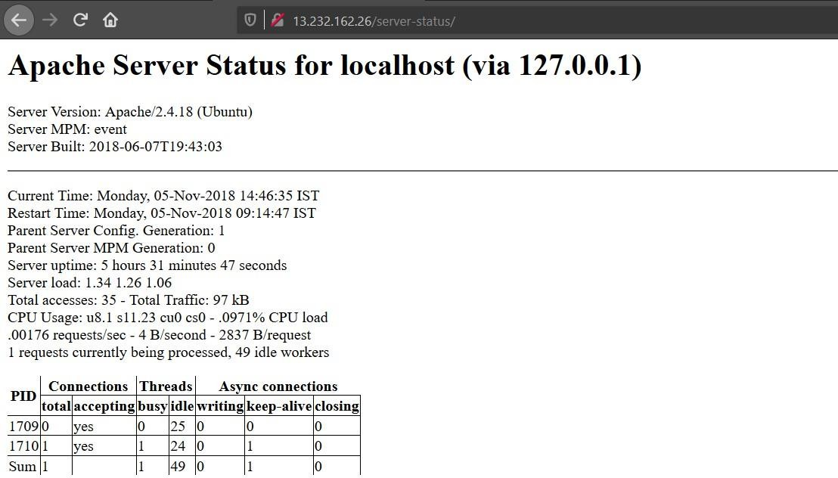
PoC – server-status/

Slide 80
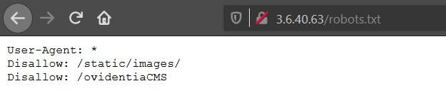
PoC – robots.txt

Slide 81
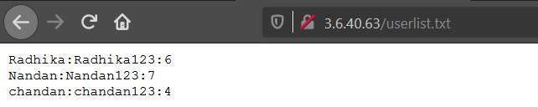
PoC – userlist.txt

Slide 82
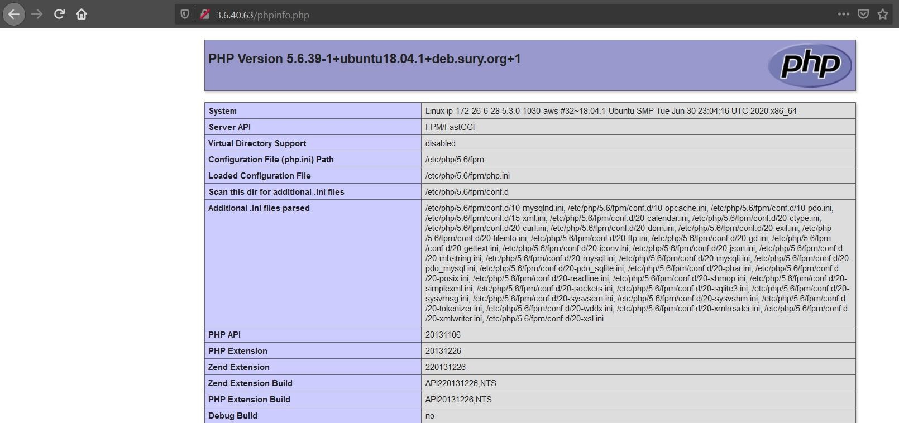
PoC – phpinfo.php

Slide 83
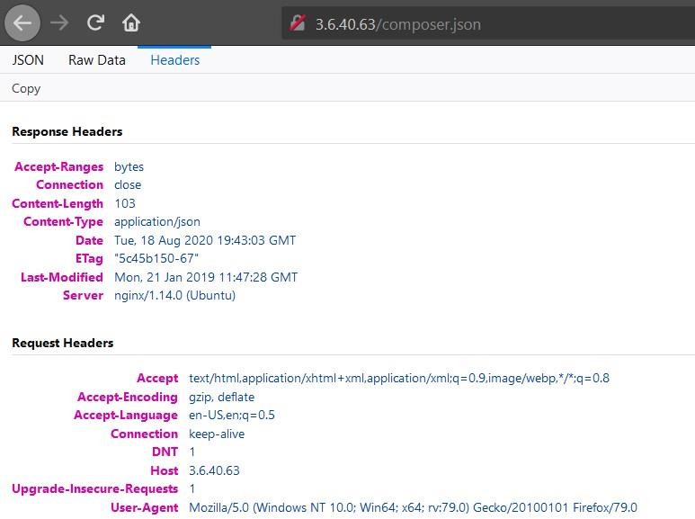
PoC – composer.json

Slide 84
Business Impact – Low
It doesn’t harm the website directly, but it is letting the hacker collect more internal information about the website which the hacker might use against the organization.

Slide 85
Recommendation
Take the following precautions:
Developers should disable all default files and pages to be displayed publicly.

Slide 86
References
https://www.indusface.com/blog/owasp-security-misconfiguration/
https://hdivsecurity.com/owasp-security-misconfiguration

Slide 87
11. Remote File Inclusion
Remote File Inclusion (Critical) | Below mentioned URL is vulnerable to RFI. Affected URL : http://52.66.88.120/?includelang=lang/fr.php Affected Parameters : /etc/passwd (/?includelang=here) https://www.google.co.in/ (/?includelang=here)

Slide 88

Observations
Navigate to the website and click on change language dropdown, and select any of the two languages.
Now, notice the URL, you get a ‘get’ parameter of includelang which is vulnerable to file inclusion.
Here, we enter the payload: includelang=/etc/passwd and on executing this file gives us the username.

Slide 89

PoC - attacker can upload shells
Attacker can exploit the referencing function in an application to upload malware (e.g., backdoor shells) from a remote URL located within a different domain.

Slide 90
Business Impact – Extremely High
Any attacker can have the root access of your website.
He can execute commands.
Through the website, he can have access of the server and can infect other websites hosted on that server.
He can even deface your websites.

Slide 91
Recommendation
To safely parse user-supplied filenames it’s much better to maintain a whitelist of
acceptable filenames.
Use a corresponding identifier (not the actual name) to access the file. Any request containing an invalid identifier can then simply be rejected(this is the approach that OWASP recommends).

Slide 92
References
https://www.pivotpointsecurity.com/blog/file-inclusion-vulnerabilities/
https://www.netsparker.com/blog/web-security/local-file-inclusion-vulnerability/
https://en.wikipedia.org/wiki/File_inclusion_vulnerability

Slide 93
12. Directory Listing
Directory Listing (Moderate) | Below mentioned URL leaks critical information via directory listing vulnerability. Affected URL: http://13.232.162.26/static/images/uploads/products/reebok.jpeg

Slide 94
12. Directory Listing
Directory Listing (Moderate) | Here are other similar URLs that leaks critical information via directory listing vulnerability. Affected URL: http://13.232.162.26/robots.txt

Slide 95

Observation
Navigate to http://13.232.162.26/products.php
Now, right click on the image of any product and then select View Image or you can even drag the image to a new
tab.
The page loads up as shown below, with the image of the selected product.\
Notice the URL, it actually reveals the full path of the image.

Slide 96

PoC – directory listings
Now, if we remove the image name (here, reebok.jpeg) and hit enter.
The following page with tons of information in it, will be displayed.

Slide 97

Observation
Navigate to http://13.232.162.26/robots.txt
It shows all the sections of your server you don’t want robots to use/visit.

Slide 98

PoC – directory listings
Navigate to http://13.232.162.26/static/images/
Complete listing of directory is shown containing the images of all the customers along with the images of all the products in the website and also the administrator directory is also visible.

Slide 99
Business Impact – High
Although this vulnerability does not have a direct impact to users or the server, though it can aid the attacker with information about the server and the users.
Also, an attacker can take important information like what all products are being sold by the sellers and can simply download the images, view them and can even use them against the users or the organization.

Slide 100
Recommendation
Take the following precautions:
Two- Factor Authentication for sensitive data should be added with strong passwords.
Find all PII stored and encrypt them with various techniques.
Disable Directory Listing .
Put an index.html in all folders with default message.

Slide 101
References
https://cwe.mitre.org/data/definitions/548.html
https://www.netsparker.com/blog/web-security/disable-directory-listing-web-servers/

Slide 102
13. PII Leakage
PII Leakage (Moderate) | Below mentioned URL is vulnerable to personnel identifiable information leakage. Affected URL : http://3.6.40.63/profile/16/edit/

Slide 103

Observation
Login to your account and go to Products page.
In every product page the Seller Info is available, click on it.

Slide 104

PoC – pan card details are shown
Upon clicking on Seller Info; Seller Name, Rating, City, Email along with PAN Card Details are shown.

Slide 105
Business Impact – High
Leaking critical information like PAN Card details to everyone is highly vulnerable as, hackers can use such information to socially hack them.

Slide 106
Recommendation
Hide critical information like the PAN Card details.
Display only minimal required information about the sellers.

Slide 107
References
https://www.imperva.com/learn/data-security/personally-identifiable-information-pii/
https://hackerone.com/reports/374007

Slide 108
14. Open Redirection
Open Redirection (Severe) | Below mentioned URL is vulnerable to open redirection. Affected URL : http://13.233.65.117/redirect.php?url=www.radhikafancystore.com Affected Parameters : url

Slide 109

Observation
Login to your account and go to Products page.
In every product page the Brand Website is available, click on it.

Slide 110

Observation
Upon clicking on Brand Website, we are then being redirected to the brand’s website.

Slide 111

Observation
Now, change the url from the brand website to some other website, here we use https://www.google.co.in/ and hit enter.

Slide 112

PoC – open redirection
We have been redirected to the destination url.

Slide 113
Business Impact – High
The hacker can redirect your page to a malicious page or some other phishing sites.

Slide 114
Recommendation
Check your Referrers.
Design your app to avoid URL redirects or forwards as a best practice. If unavoidable, encrypt the
target URL such that the URL:token mapping is validated on the server.
Verify URL patterns using regular expressions to check if they belong to valid URLs. However, malicious URLs can pass that check.

Slide 115
References
https://www.netsparker.com/blog/web-security/open-redirection-vulnerability-information- prevention/
https://spanning.com/blog/open-redirection-vulnerability-web-based-application-security-part-1/
https://www.trustwave.com/en-us/resources/blogs/spiderlabs-blog/understanding-and- discovering-open-redirect-vulnerabilities/

Slide 116
15. Bruteforce Exploitation of Coupon Codes
Bruteforce Exploitation (Severe) | Below mentioned URL is vulnerable to brute forcing and can be exploited for discounts. Affected URL : http://15.207.106.113/cart/apply_coupon.php

Slide 117

Observation
Upon adding items to the cart, you will end up in a screen like this, where we see the apply coupon section and an example.
Type in UL_6666 in the apply coupon section and intercept the request using Burp Suite.

Slide 118

Observation
Following request will be generated containing coupon code.

Slide 119

Observation
We shoot the request with all possible combinations of 4 Digit numbers and upon a successful hit, we get a response containing the valid coupon code. We can use this code to get the discount.
Valid coupon code for this website is UL_1247.

Slide 120

PoC – coupon code applied successfully

Slide 121
Business Impact – Severe
Attacker can easily order the items on extreme discounts which in turn will cause huge loss to the company.

Slide 122
Recommendation
Coupon codes should have limited number of uses and should be regenerated after sometime.
Coupon code should be random alpha-numeric characters.

Slide 123
References
https://www.digitalcommerce360.com/2017/03/17/prevent-fraud-brute-force-online-coupon-gift- card-attacks/
https://www.couponxoo.com/brute-force-attack-coupon-code

Slide 124
16. Command Execution Vulnerability
Command Execution Vulnerability (Critical) | Below mentioned URLs is vulnerable to command execution, Affected URLs : http://13.233.65.117/wondercms/files/b374kmini.php http://13.127.150.195/admin31/console.php

Slide 125

Observation
Navigate to the Blog section of the website and login as admin.
Now, navigate to the Settings and then go to Files option.
You will notice an Remove Files section here, click on /wondercms/files/b374kmini.php

Slide 126

Observation
It looks like, this is a small and simple PHP-shell that has an explorer, allows shell command execution, mysql
queries, and more.

Slide 127

PoC – command execution
Type in the Command: whoami and press Go!
The command was executed successfully.

Slide 128

Observation
As a customer, Login to your account.
Now, forcefully type in the url for going to the admin console http://13.127.150.195/admin31/console.php (you came to know about this url while testing vulnerabilities for Vulnerability Report No. 4, Rate Limiting Flaws), and press enter.

Slide 129


PoC – command execution
It seems like we can execute commands here, let’s try by typing whoami and press SUBMIT!
The command was executed successfully.

Slide 130
Business Impact – Extremely High
The consequences of command execution can vary:-
including complete system takeover, an overloaded file system or database.
forwarding attacks to back-end systems.
client-side attacks, or simple defacement.

Slide 131
Recommendation
Hide all files in the Upload Screen.
Delete all php shells.

Slide 132
References
https://miniphpshell.wordpress.com/2009/10/13/b374k-mini-shell/
https://owasp.org/www-community/attacks/Command_Injection

Slide 133
17. Forced Browsing
Forced Browsing (Severe) | Below mentioned URLs is vulnerable to forced browsing. Affected URL : http://13.233.24.9/ Forced URLs : http://13.233.65.117/admin31/dashboard.php http://13.127.150.195/admin31/console.php

Slide 134
Observation
As a customer, Login to your account.
Now, forcefully type in the url for going to the admin dashboard http://13.233.65.117/admin31/dashboard.php (you
came to know about this url while testing vulnerabilities for Vulnerability Report No. 4, Rate Limiting Flaws).

Slide 135

PoC – admin dashboard access
Here is the access to the complete admin dashboard just by entering its complete url.

Slide 136
PoC – admin console access
Here is the access to the admin console just by entering its complete url.

Slide 137
Business Impact – Severe
Attacker can have all the admin privileges.
He can edit all the items.
He can execute any harmful command through console.

Slide 138
Recommendation
Server side security checks should be performed perfectly.
Make the admin page url complicated so that it couldn’t be guessed.

Slide 139
References
https://owasp.org/www-community/attacks/Forced_browsing
https://campus.barracuda.com/product/webapplicationfirewall/doc/42049348/forced-browsing-
attack/

Slide 140
18. Cross-Site Request Forgery
Cross-Site Request Forgery (Severe) | Below mentioned URLs are vulnerable to cross-site request forgery. Affected URLs : http://13.233.24.9/profile/change_password.php http://13.233.24.9/cart/cart.php

Slide 141

Observation
As a customer, Login to your account.
Go to My Profile section and click on Change Password button, a change password page appears.
Let’s see if we can forge the request some how, let’s try is by creating a HTML page.

Slide 142


PoC – password changed successfully
Now, make a HTML page to update/change your password.
Type in a new set of password and click on Update button, upon clicking on it, we get a Success Message.
Now, logout and try to login again with your new password, you will be logged in successfully.

Slide 143

Observation
As a customer, Login to your account.
Shop any product and add it to your cart.
Let’s see if we can confirm this order without directly pressing on the CONFIRM ORDER button on this page, let’s try it by creating a HTML page.

Slide 144

PoC – order confirmed successfully
Now, make a HTML page to confirm your order.

Slide 145

PoC – order confirmed successfully
Just click on Confirm Order button in our HTML page, and the order confirmation page will load in the same window.

Slide 146
Business Impact – Severe
Attacker can change the password by uploading phishing pages and take complete control of the user account and use it to plan further attacks on the company.
Attacker can confirm the order without consent of user which in turn can lead to a huge loss for the
company.

Slide 147
Recommendation
Use tokens and session cookies.
Ask the user his password (temporary like OTP or permanent like login password) at every
critical action like while deleting account, making a transaction, changing the password etc.
Implement the concept of CSRF tokens which attach a unique hidden password to every user in every <form>. Read the documentation related to the programming language and framework being used by your website
Check the referrer before carrying out actions. This means that any action on x.com should check that the HTTP referrer is https://x.com/* and nothing else like https://x.com.hacker.com/*

Slide 148
References
https://owasp.org/www-community/attacks/csrf
https://en.wikipedia.org/wiki/Cross-site_request_forgery
https://portswigger.net/web-security/csrf

Slide 149
19. Seller Account Access
Seller Account Access (Critical) | Below mentioned URL shows the seller accounts and passwords. Affected URL : http://15.206.159.87/userlist.txt

Slide 150

Observation
Navigate to the website, at the homepage add /userlist.txt after the URL, the following page is opened.

Slide 151

PoC - attacker has the seller dashboard access
On entering the credentials in the seller account we got from http://15.206.159.87/userlist.txt, we
have accessed the seller’s dashboard.

Slide 152
PoC

Slide 153
Business Impact – Extremely High
Attacker can access the seller dashboard and then can edit the product’s name, image, and even the price of the products he/she is selling, which in turn can harm the seller’s reputation and even the company might face losses for the same.

Slide 154
Recommendation
The developer should disable these confidential default pages which reveals the username and
password of the sellers.

Slide 155
References
https://www.indusface.com/blog/owasp-security-misconfiguration/
https://hdivsecurity.com/owasp-security-misconfiguration

Slide 156
THANK YOU
For any further clarifications/patch assistance, please contact: tanishekverma04@gmail.com

